Slide 1
What is a Chi-Square Test and Why Do We use it?

Slide 2
A Chi-Square test is a test of statistical significance for categorical variables.
For Example:
A research scholar is interested in the relationship between the placement of students in the statistics department of a reputed University and their C.G.P.A (their final assessment score).
He obtains the placement records of the past five years from the placement cell database (at random).
He records how many students who got placed fell into each of the following C.G.P.A. categories – 9-10, 8-9, 7-8, 6-7, and below 6.

Slide 3
If there is no relationship between the placement rate and the C.G.P.A., then the placed students should be equally spread across the different C.G.P.A. categories (i.e. there should be similar numbers of placed students in each category).
However, if students having C.G.P.A more than 8 are more likely to get placed, then there would be a large number of placed students in the higher C.G.P.A. categories as compared to the lower C.G.P.A. categories. In this case, the data collected would make up the observed frequencies.

Slide 4
So the question is, are these frequencies being observed by chance or do they follow some pattern?
Here enters the chi-square test! The chi-square test helps us answer the above question by comparing the observed frequencies to the frequencies that we might expect to obtain purely by chance.
Chi-square test in hypothesis testing is used to test the hypothesis about the distribution of observations/frequencies in different categories.

Slide 5
Assumptions of the Chi-Square Test
Just like any other statistical test, the chi-square test comes with a few assumptions of its own:
The χ2 assumes that the data for the study is obtained through random selection, i.e. they are randomly picked from the population
The categories are mutually exclusive i.e. each subject fits in only one category. For e.g.- from our above example – the number of people who lunched in your restaurant on Monday can’t be filled in the Tuesday category
The data should be in the form of frequencies or counts of a particular category and not in percentages
The data should not consist of paired samples or groups or we can say the observations should be independent of each other
When more than 20% of the expected frequencies have a value of less than 5 then Chi-square cannot be used. To tackle this problem: Either one should combine the categories only if it is relevant or obtain more data

Slide 6
Types of Chi-Square Tests (By manual calculations)

Slide 7
Chi-Square Goodness of Fit Test
This is a non-parametric test. We typically use it to find how the observed value of a given event is significantly different from the expected value. In this case, we have categorical data for one independent variable, and we want to check whether the distribution of the data is similar or different from that of the expected distribution.

Slide 8
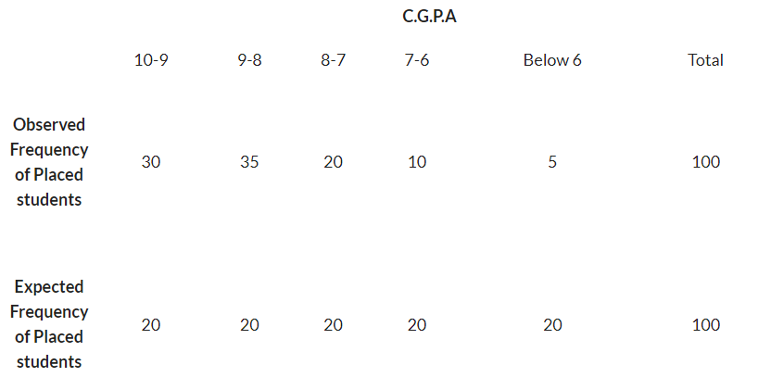
Let’s consider the above example where the research scholar was interested in the relationship between the placement of students in the statistics department of a reputed University and their C.G.P.A.
In this case, the independent variable is C.G.P.A with the categories 9-10, 8-9, 7-8, 6-7, and below 6.
The statistical question here is: whether or not the observed frequencies of placed students are equally distributed for different C.G.P.A categories (so that our theoretical frequency distribution contains the same number of students in each of the C.G.P.A categories).
We will arrange this data by using the contingency table which will consist of both the observed and expected values as below:

Slide 9
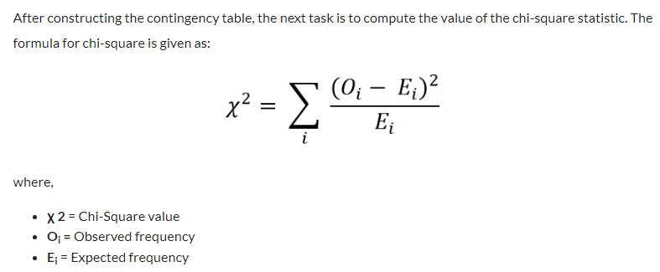

Slide 10
Let us look at the step-by-step approach to calculate the chi-square value:
Step 1: Subtract each expected frequency from the related observed frequency. For example, for the C.G.P.A category 10-9, it will be “30-20 = 10”. Apply similar operation for all the categories
Step 2: Square each value obtained in step 1, i.e. (O-E)². For example: for the C.G.P.A category 10-9, the value obtained in step 1 is 10. It becomes 100 on squaring. Apply similar operation for all the categories
Step 3: Divide all the values obtained in step 2 by the related expected frequencies i.e. (O-E)²/E. For example: for the C.G.P.A category 10-9, the value obtained in step 2 is 100. On dividing it with the related expected frequency which is 20, it becomes 5. Apply similar operation for all the categories
Step 4: Add all the values obtained in step 3 to get the chi-square value. In this case, the chi-square value comes out to be 32.5
Step 5: Once we have calculated the chi-square value, the next task is to compare it with the critical chi-square value. We can find this in the below chi-square table against the degrees of freedom (number of categories – 1) and the level of significance: Next Slide

Slide 11
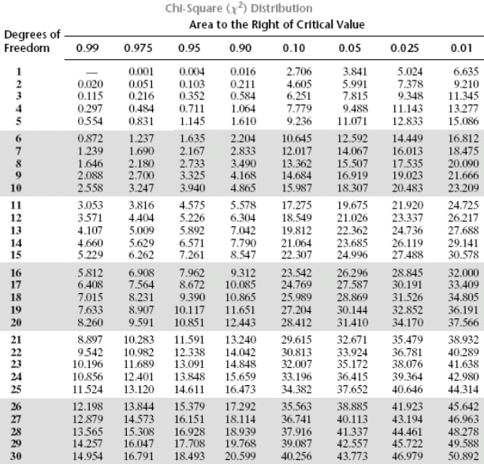

Slide 12
In this case, the degrees of freedom are 5-1 = 4. So, the critical value at 5% level of significance is 9.49.
Our obtained value of 32.5 is much larger than the critical value of 9.49.
Therefore, we can say that the observed frequencies are significantly different from the expected frequencies. In other words, C.G.P.A is related to the number of placements that occur in the department of statistics.

